Slide 1
Wireless Infrared Receiver Design EEGR 317
Christopher Adams
Tyree Miles Jr
12/06/2018

Slide 2
Objective
Detect infrared light using a Photo Detector.
Amplify the signal received from the Photo Detector using a BJT.
Digitalize the signal & display said signal via Oscilloscope.

Slide 3
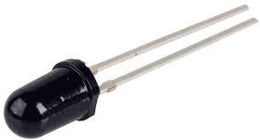
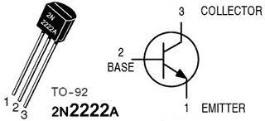
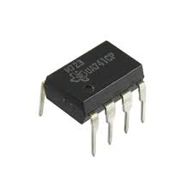
Components
Infrared LED
(To Detect Infrared)
NPN Bipolar-Junction Transistor
(For Amplification)
Operational Amplifier
(For Digitalizing the Signal)

Slide 4
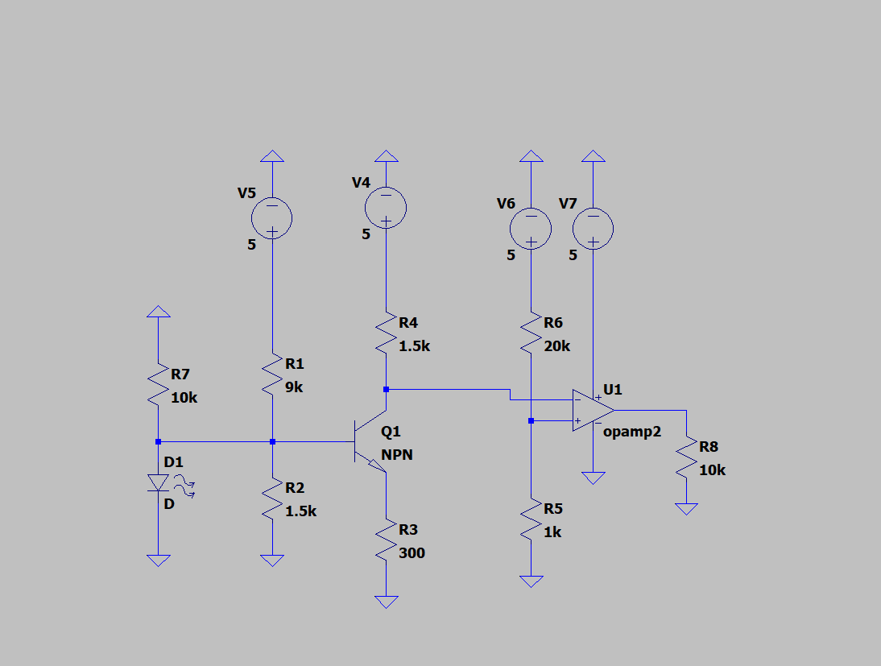
Schematic

Slide 5
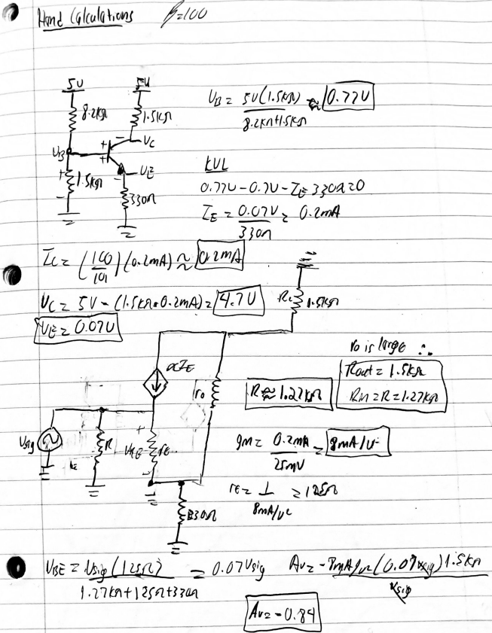
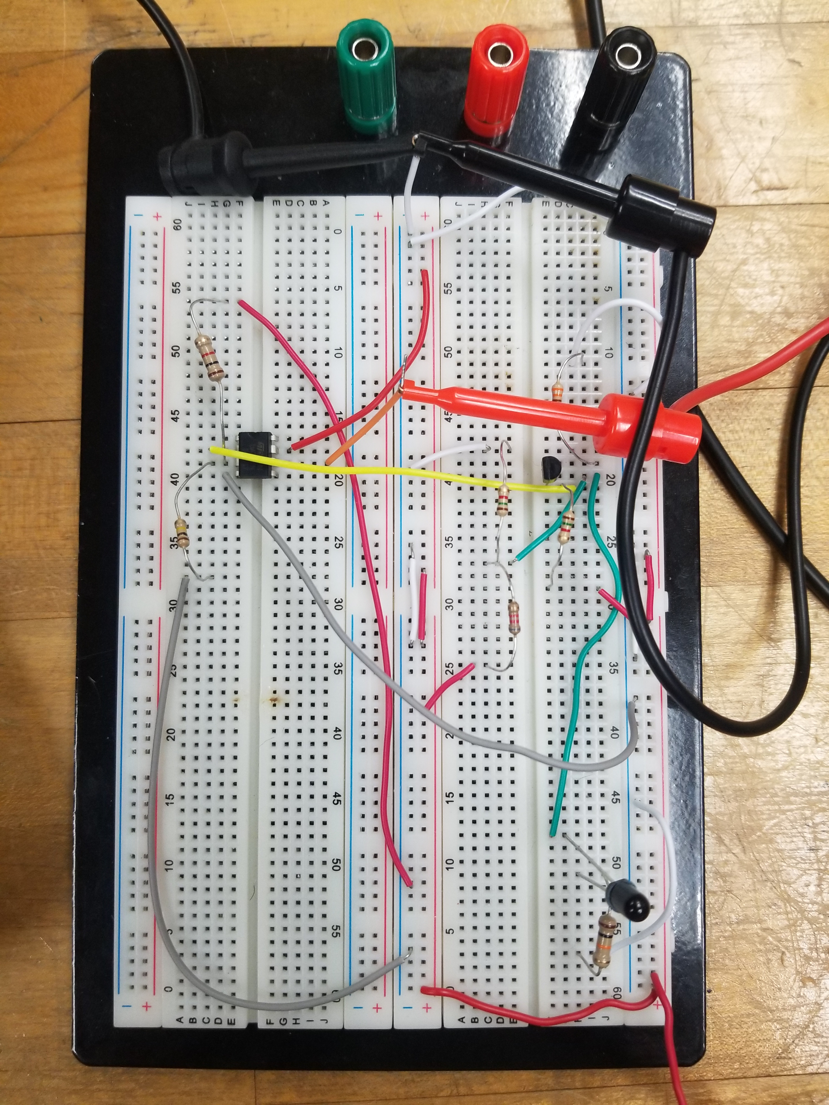
Circuit Design w/ Hand Calculations

Slide 6
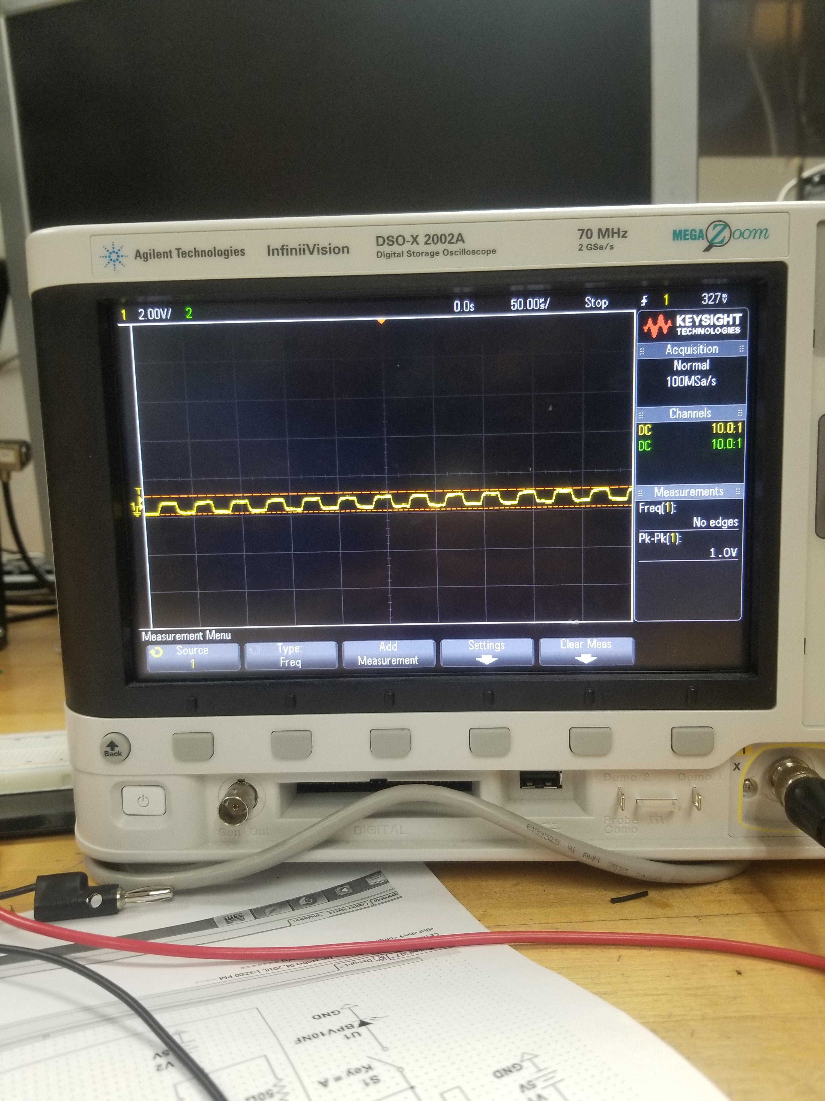
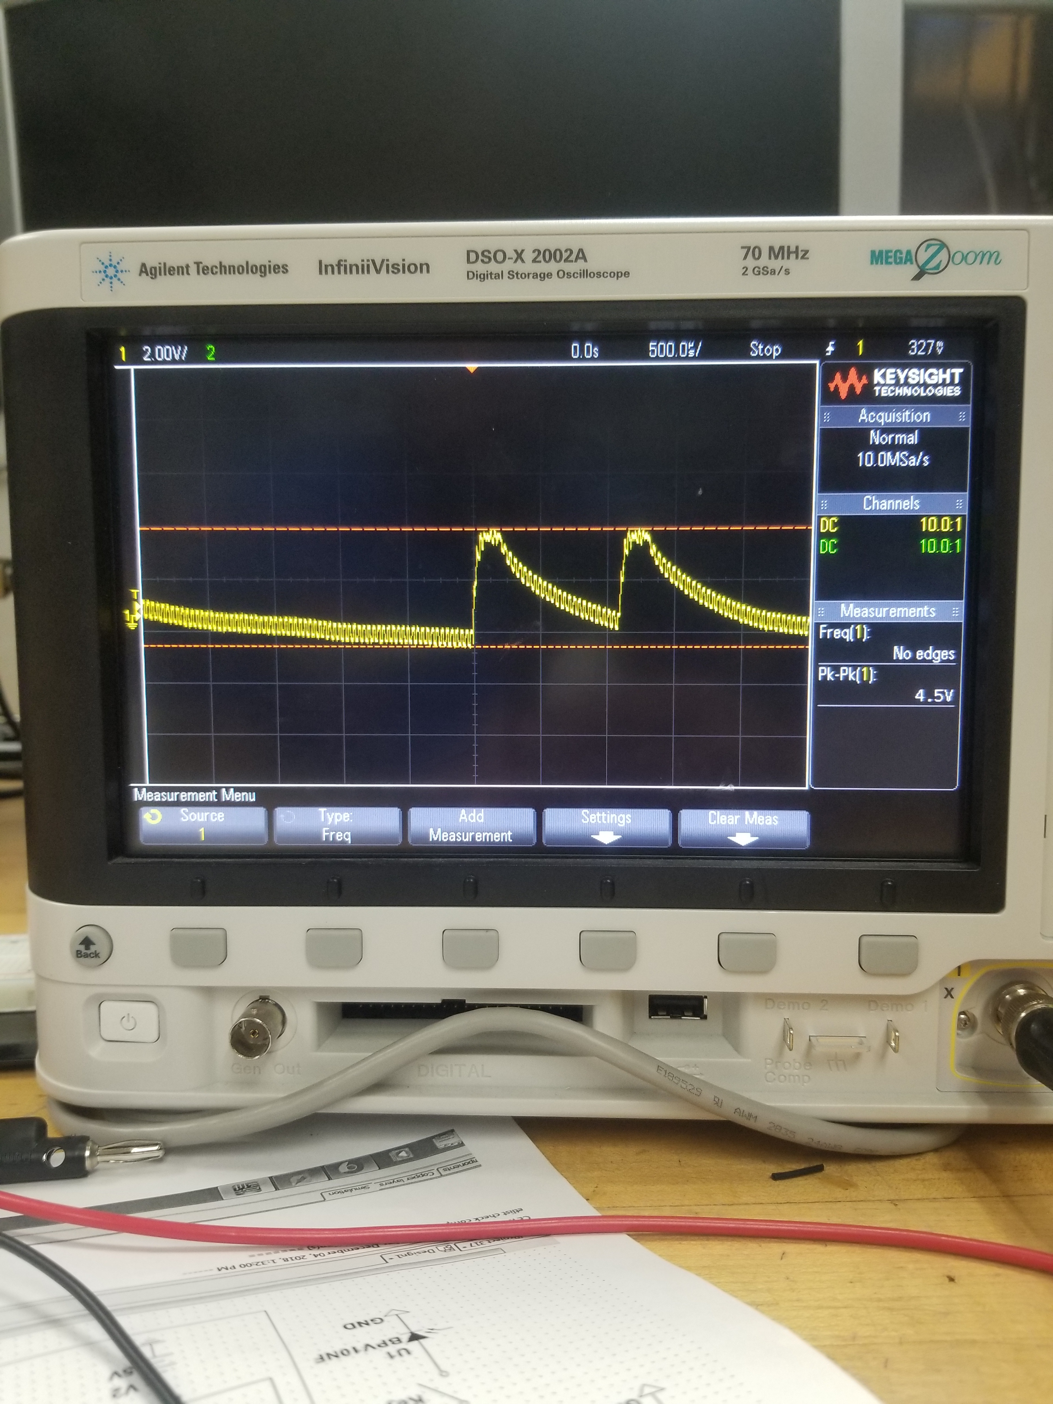
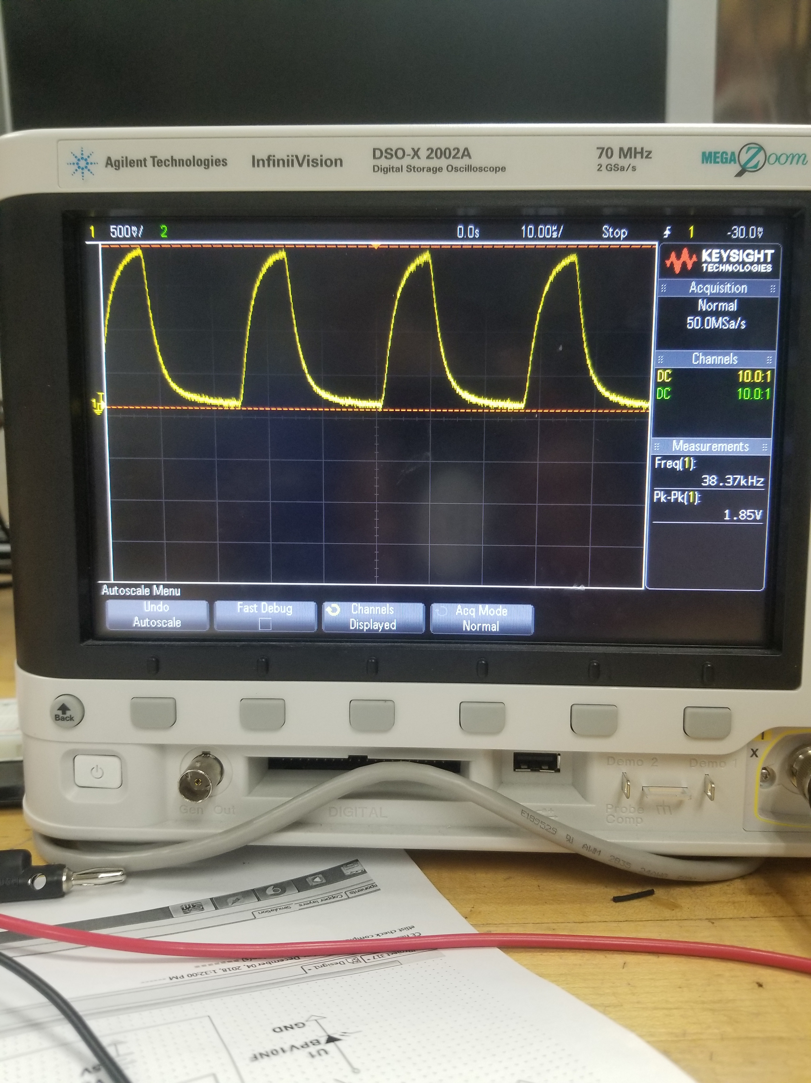
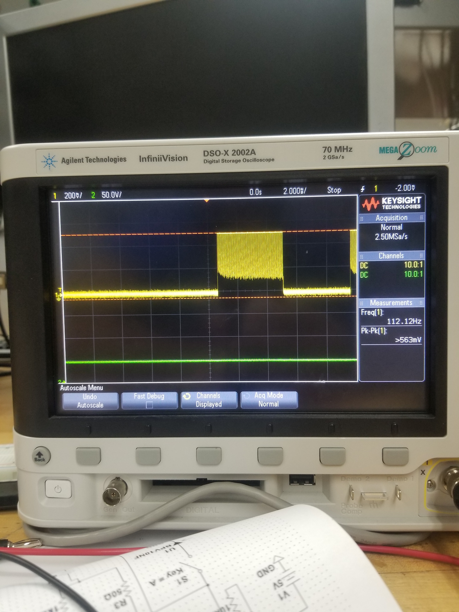
Outputs via Oscilloscope
No Infrared Light Infrared Light Amplification of Light via BJT Digitalized Signal

Slide 7
Conclusion
After producing an amplified signal, we can conclude that the BJT is a nice & (personal opinion) ideal form of amplification for signals.
Also, using a photo diode is a lot easier to use because there is a small risk for the device to short out.
We discovered that different remotes will give out different signals based on the oscilloscope.

